Slide 1
Micro Credit Loan Defaulter

Slide 2
Introduction
A Microfinance Institution (MFI) is an organization that offers financial services
to low income populations. MFS becomes very useful when targeting especially
the unbanked poor families living in remote areas with not much sources of
income. The Microfinance services (MFS) provided by MFI are Group Loans,
Agricultural Loans, Individual Business Loans and so on.

Slide 3
Problem Statment
We are working with one such client that is in Telecom Industry. They are a fixed wireless telecommunications network provider. They have launched various products and have developed its business and organization based on the budget operator model, offering better products at Lower Prices to all value conscious customers through a strategy of disruptive innovation that focuses on the subscriber.
The sample data is provided to us from our client database. It is hereby given to you for this exercise. In order to improve the selection of customers for the credit, the client wants some predictions that could help them in further investment and improvement in selection of customers.

Slide 4
Technologies Used
Machine Learning
Machine learning algorithem build a mathematical model based on sample data, known as training data in order to make predictions and decisions.
Machine Learning algorithem are used in Email filtering , face Recongnition, etc.

Slide 5
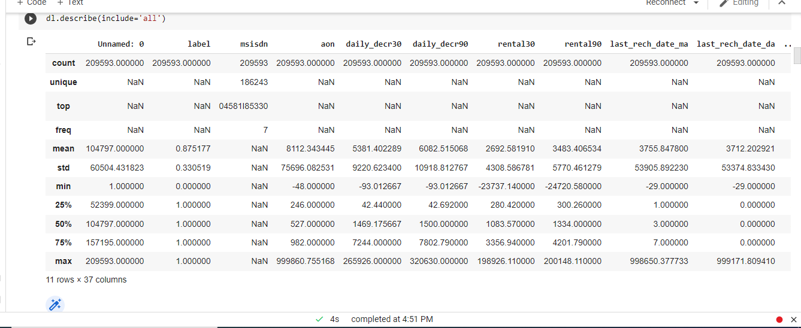
Data Description

Slide 6
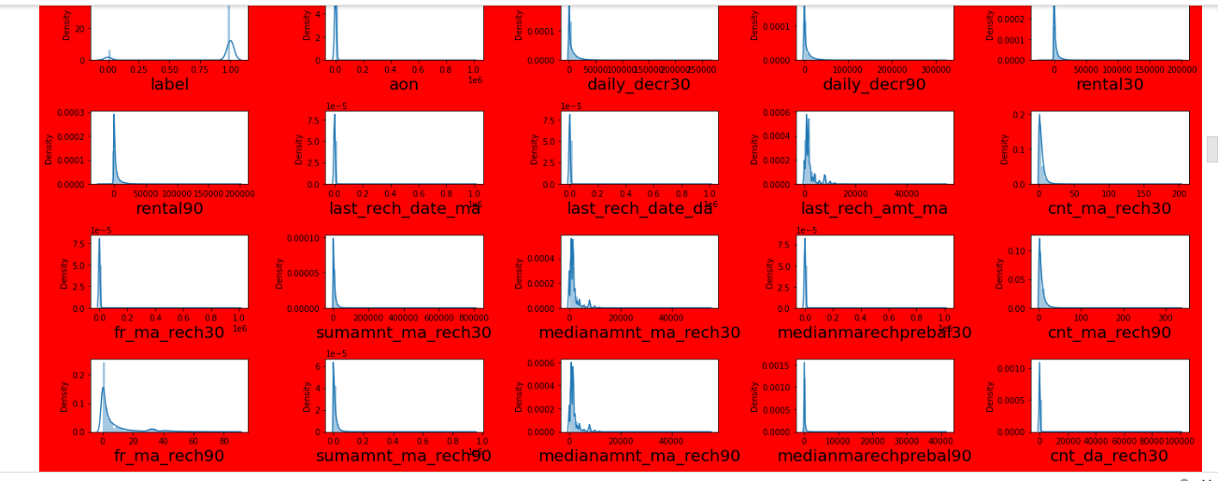
Dist plot for data distribution

Slide 7
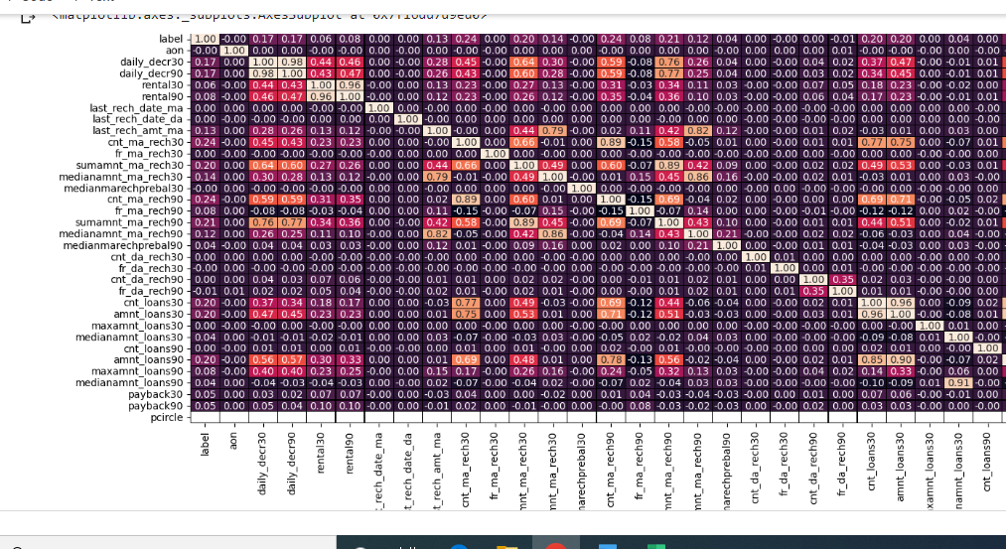
Heat map

Slide 8
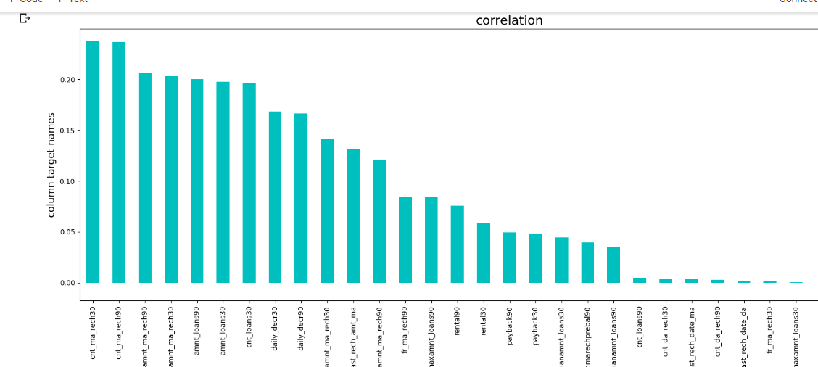
Line plot

Slide 9
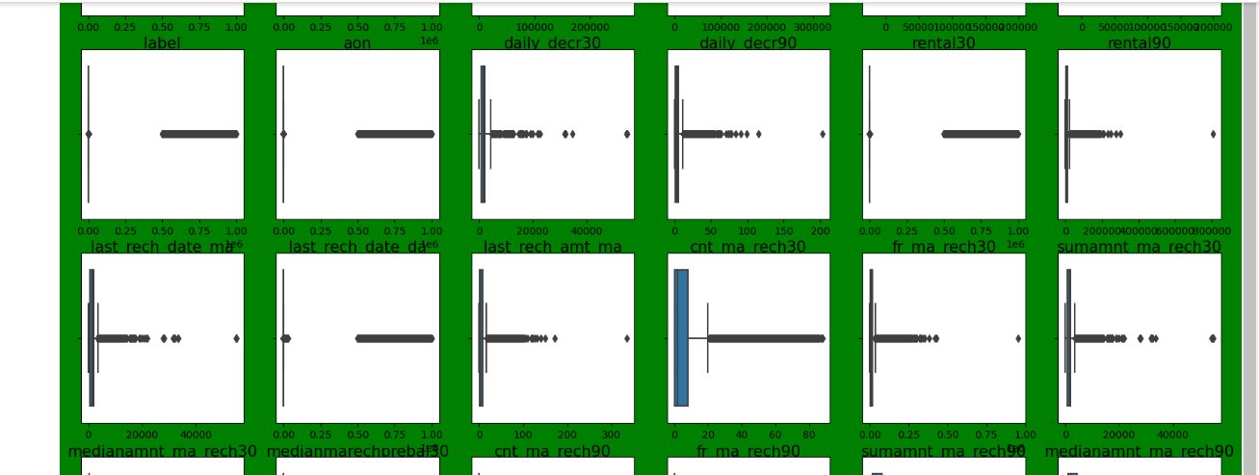
Outliers

Slide 10
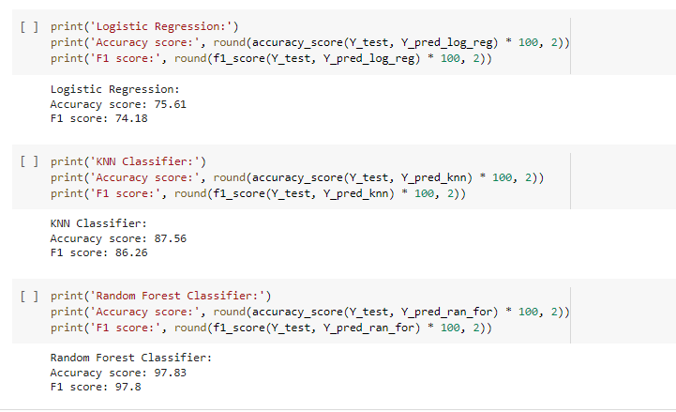
Data Modeling

Slide 11
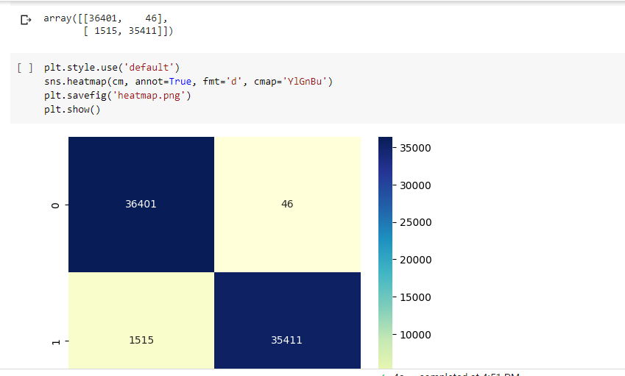
Confusion Matrix

Slide 12
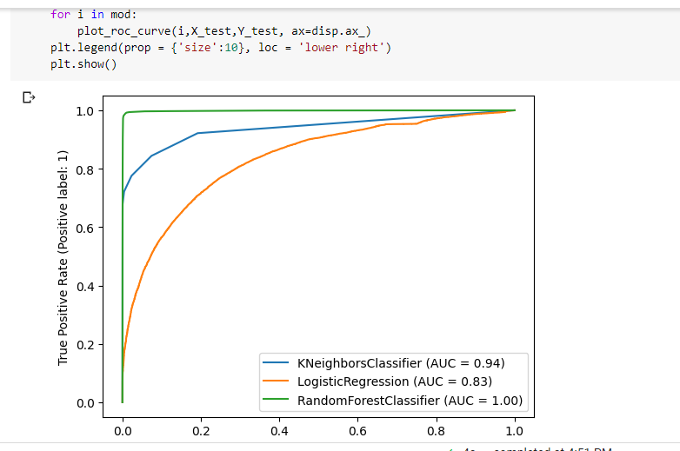
AUC and ROC curve

Slide 13
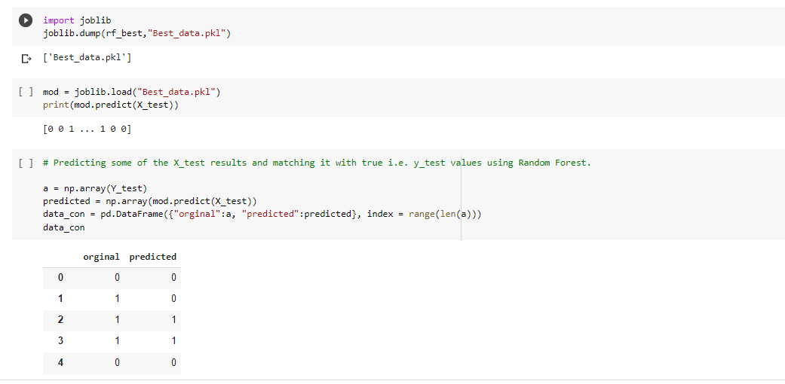
Prediction and actual data comparison

Slide 14
The END

